Slide 1



Introducing Saw-ADD The worlds ONLY
Anti Deviation Device for Bandsaws!

Slide 2
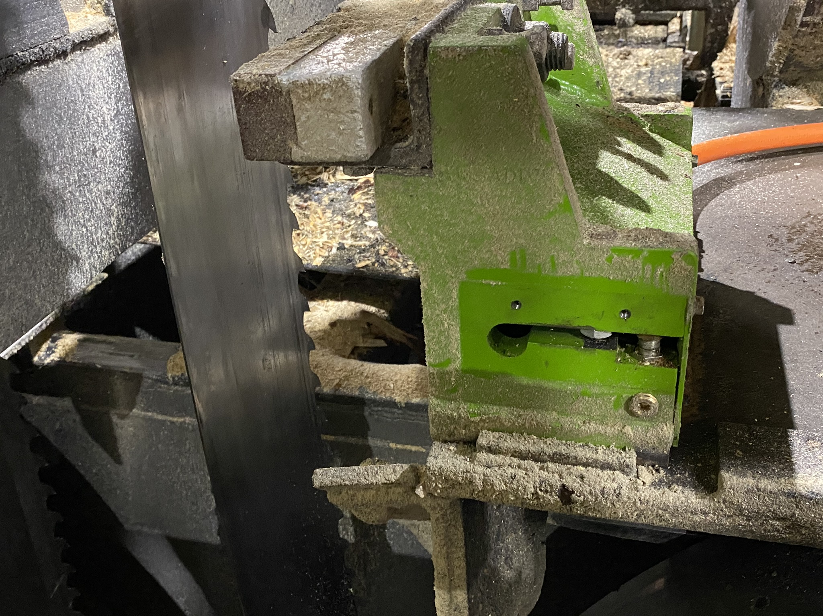
Saw-ADD integrates force sensors on the leading and trailing edge of the saw blade. This detects twisting forces on the saw blade that will steer it into deviation unless prevented by Saw-ADD.

Slide 3

Close-up shows latest design of sensor assembly integrated into sidewall of Guide Block Holder, converting it into a big load-cell. An over-travel stop prevents damage to sensors.

Slide 4
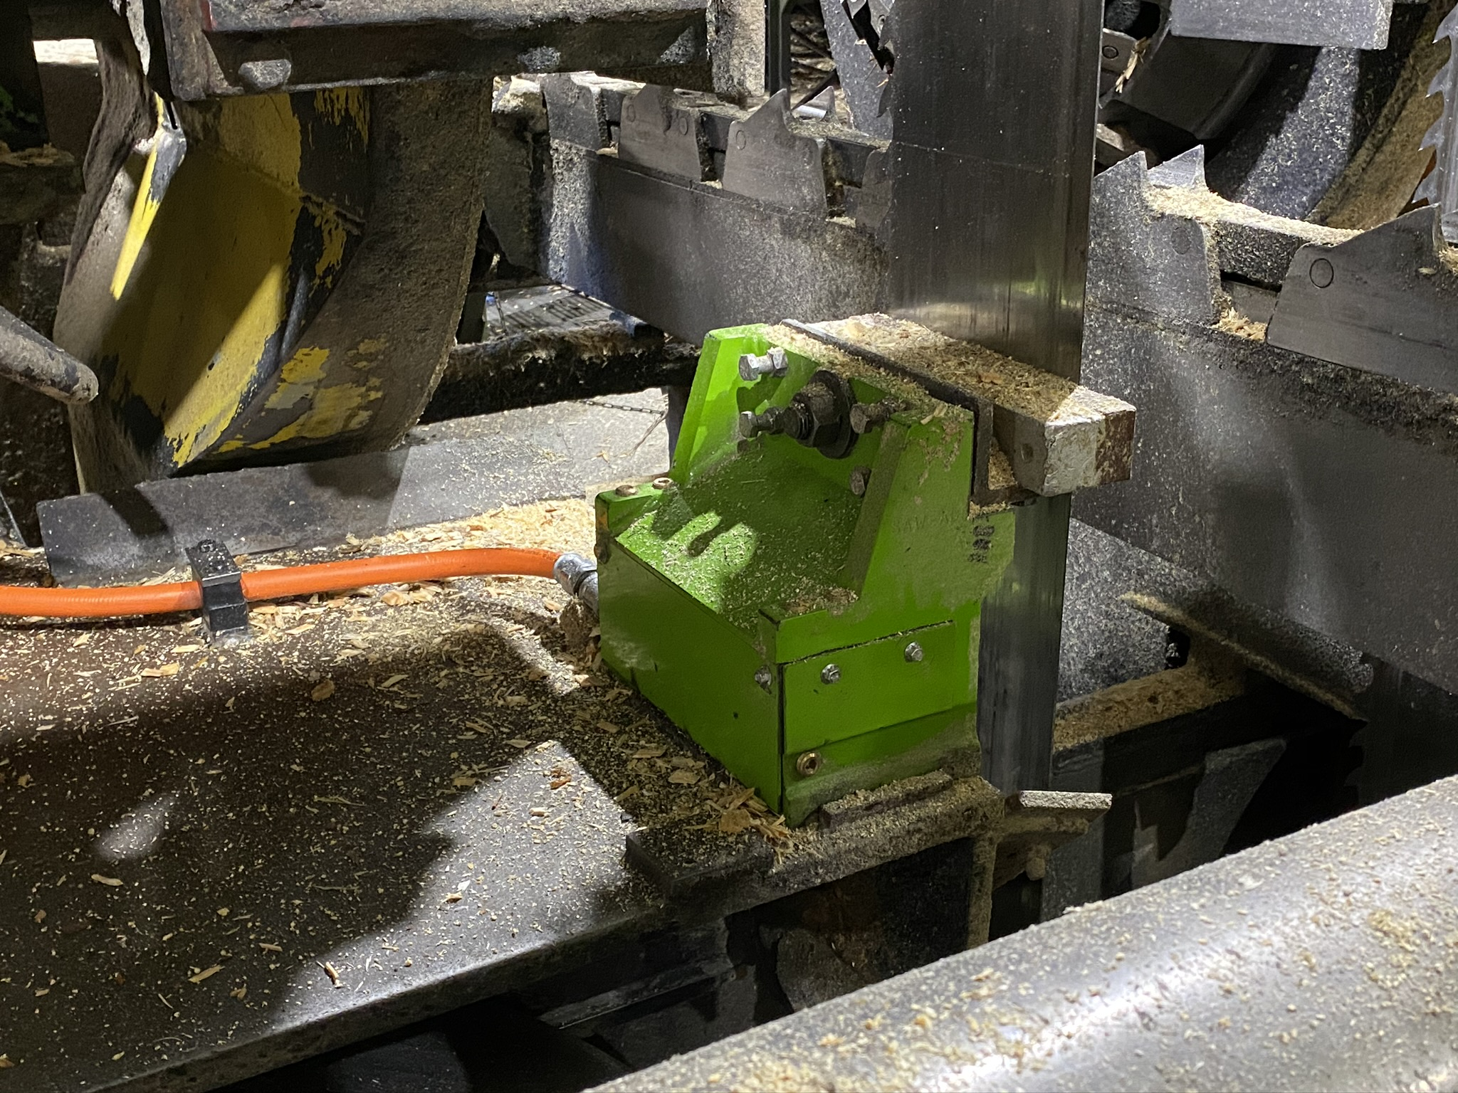
We all know you can saw most logs faster but have been sawing at conservative speeds due to the occasional tough log that will wreck a saw. Now you can cut as much as 15% faster because Saw-ADD will automatically and proportionally slow the feed-speed only for the tough ones yet still creating a higher grade of lumber!

Slide 5
With Saw-ADD you get…
Increased Production
Reduced Target Size
Higher Grade Lumber
Less Saw Changes
No Saw Wrecks
Less Saw Consumption
Safety Benefits
Less Benching
Diagnostic Capabilities

Slide 6
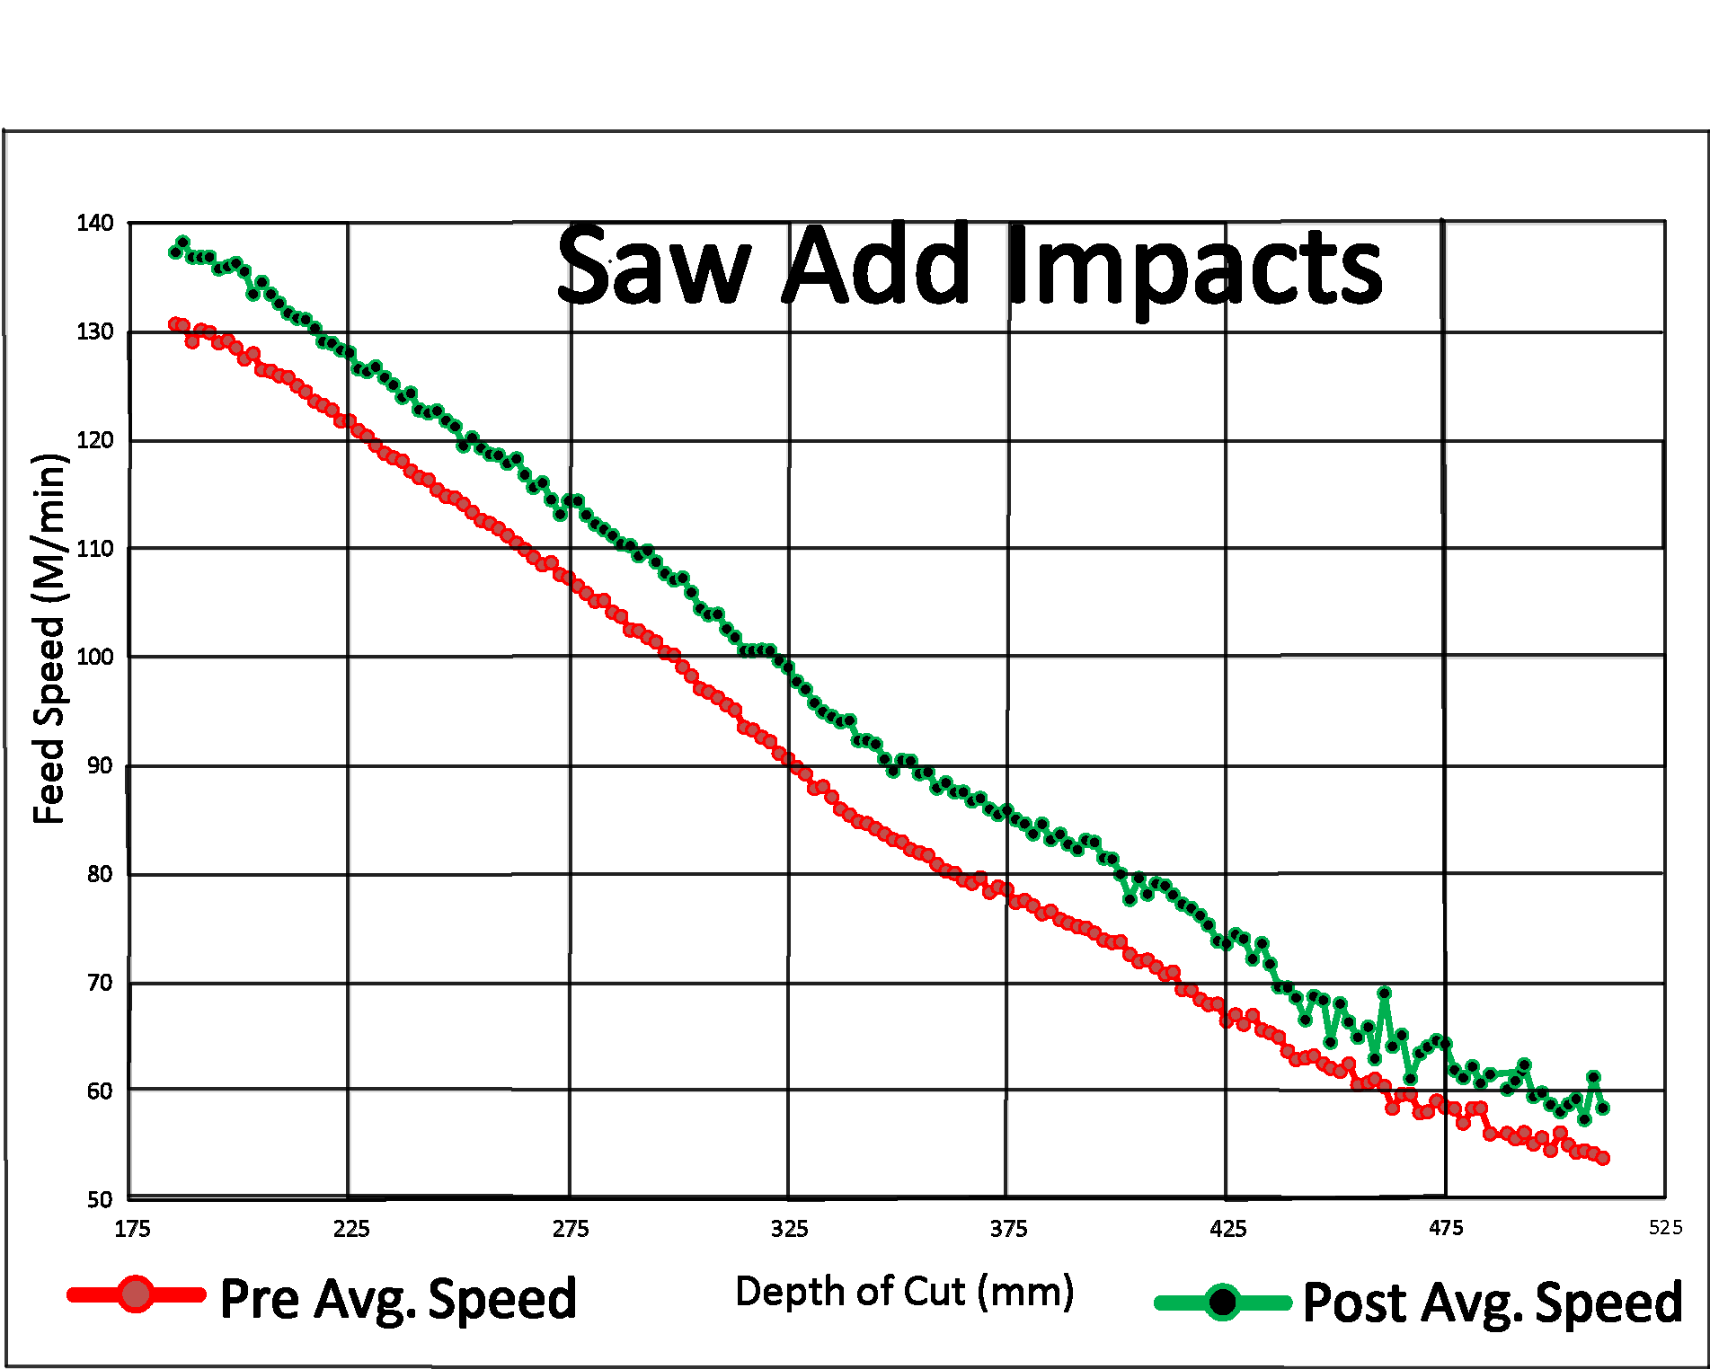
Month of data showing a nearly 8% average speed increase across all depths of cut
The red line is before Saw-ADD. The green line is after. Each dot on the lines represents 100’s of logs in each depth of cut
Each line-dot represents hundreds of logs.

Slide 7
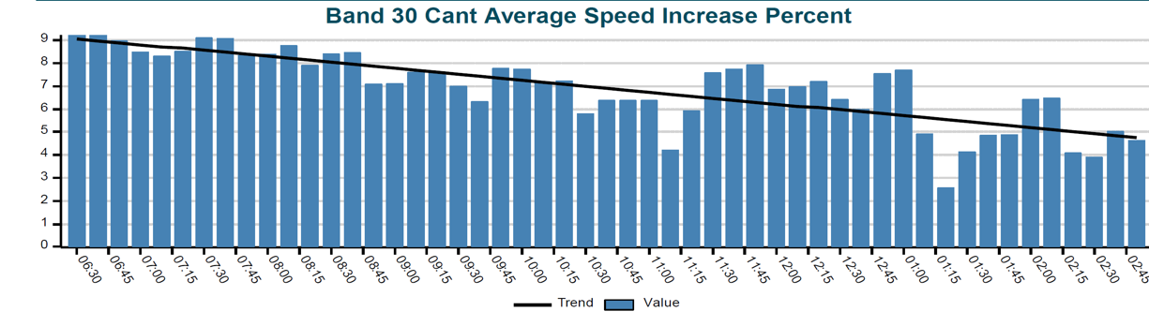




Chart shows bandsaws performance over a shift sawing frozen wood. Each bar is the 30 cant average percent speed increase over optimizer speeds. Notice the increase reduces as the saws get tired. Before Saw-ADD they would not have lasted an entire shift. If left on past lunch they would have wrecked. The speed is increased by the requested 10% upon entry and then reduced as necessary through the log. For nonfrozen wood the requested increase was as much as 15% and averaged over 10%.

Slide 8
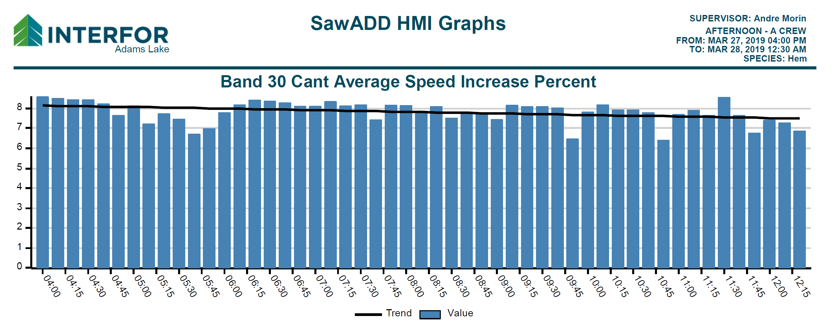
In this graph, notice the black line indicating the average is holding steady near an 8% increase with
Saw-ADD when cutting Hemlock

Slide 9
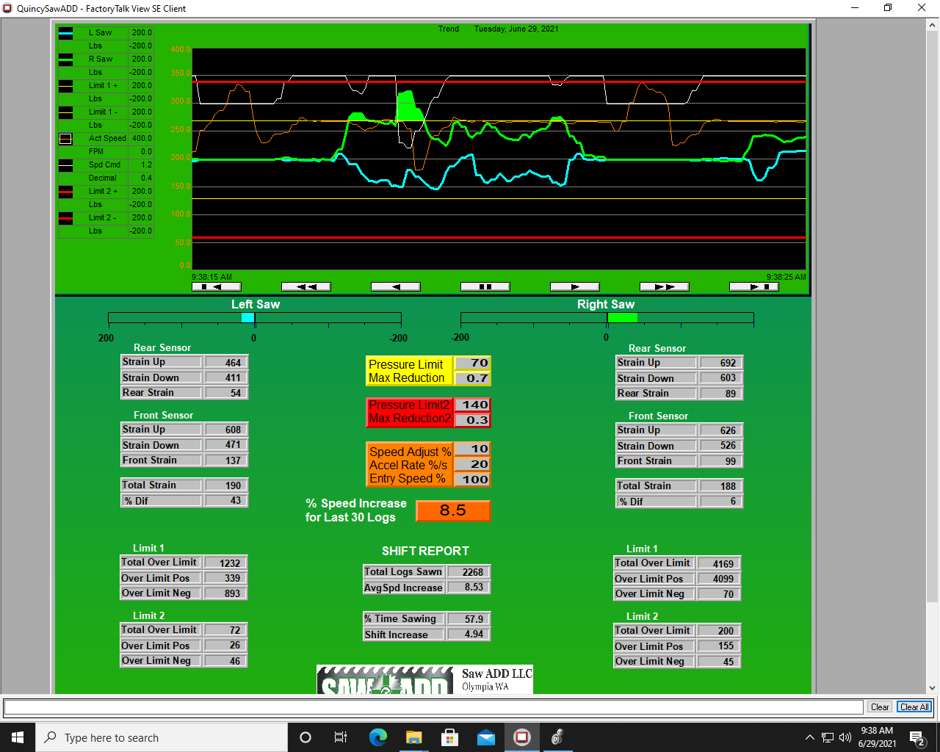

Slide 10

Saw-ADD is the only anti-deviation system available!
Top guide systems can only measure deviation that has already occurred. THAT’S TOO LATE!!
Saw-ADD keeps you ahead of the curve.

Slide 11
Introducing Saw-ADD The worlds ONLY Anti Deviation Device for Roundsaws!

Slide 12
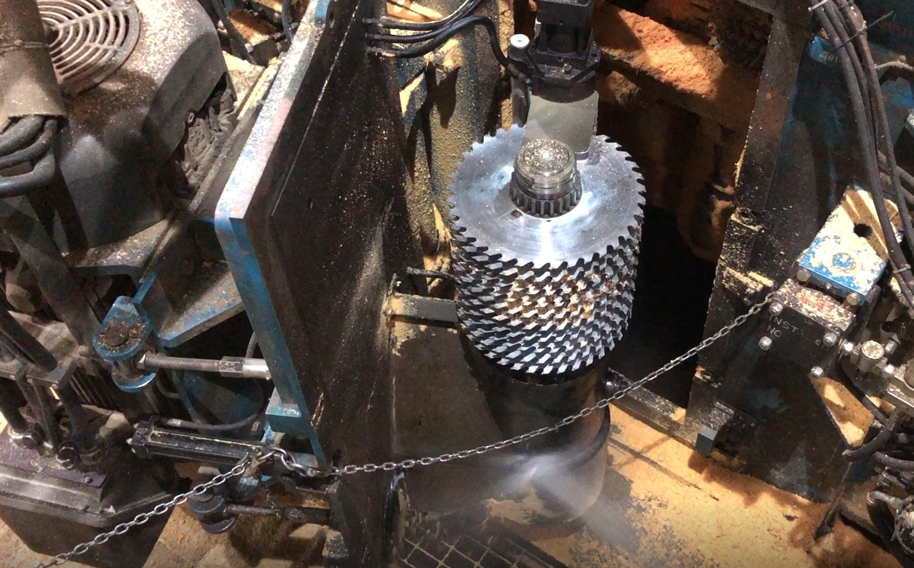

Round Saw-ADD is a patent pending saw and guide force sensing system. It measures the reaction forces on the arbor from the radial forces on the saw blades from the tooth cut and the guide friction.
Excess forces are a potential for deviation and saw damage. Saw-ADD virtually eliminates these by preemptively slowing the feed speed.

Slide 13
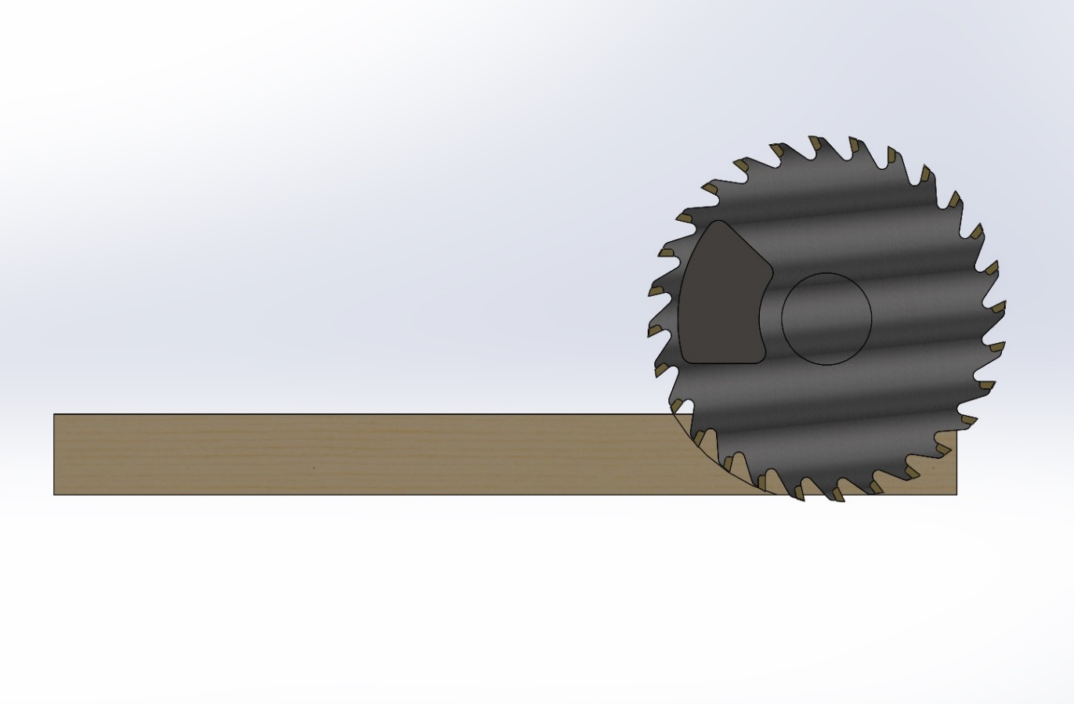

Equal & Opposite
Reaction Force
Radial Sawing Forces
Saw-ADD Measures the Sawing Force

Slide 14

Equal & Opposite
Reaction Force
Radial Friction Force
Saw-ADD Measures the Friction Force

Slide 15
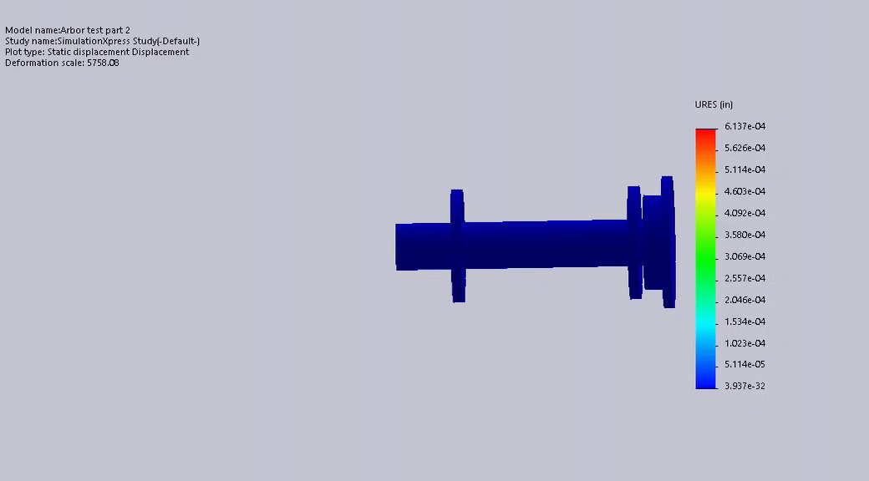

Actual movement is tenths of thousandths of an inch!
Saws
This is a simulation of radial forces on cartridge arbors caused by sawing and/or guide friction forces
(movement exaggerated).
Sensor placed here
Sensors on the arbor cartridge measure directional radial forces nearly a half second earlier than excess arbor current will occur.
Bearing
Bearing

Slide 16
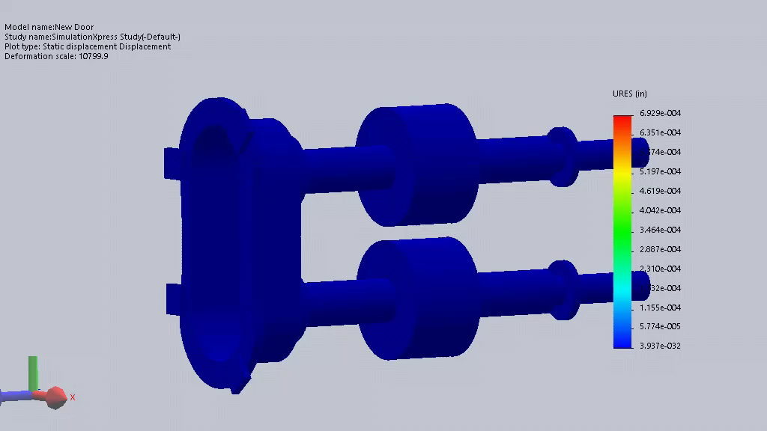

Saw ADD measures Radial Forces on Horizontal Arbors from outside the saw box. (movement exaggerated)
Sensor
tenths of thousandths of an inch!
Bearing
Bearing
Saws
Saw ADD closes the loop by automatically adjusting the feed speed during the cut.
This quick detection and subsequent action eliminates saw blade deviation which prevents sticking a cant or damaging saws
Saws
Bearing
Sensor
Bearing

Slide 17
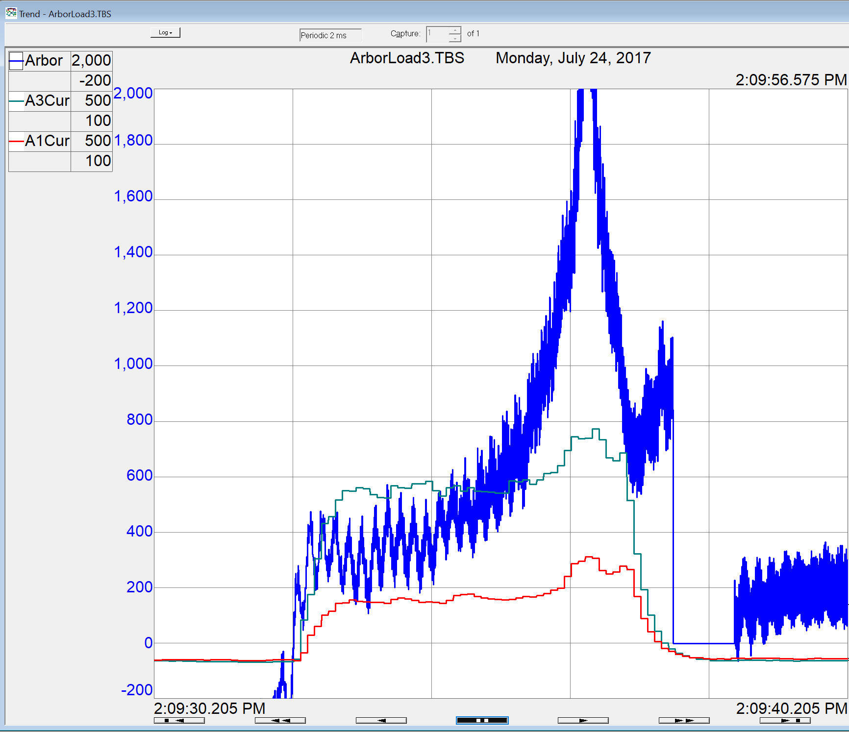

The blue trace is the sawing force on the bottom arbor of a Horizontal Curve Sawing Gang and green is the bottom arbor motor current which mimics the force, but the force shows a much higher sensitivity.

Slide 18
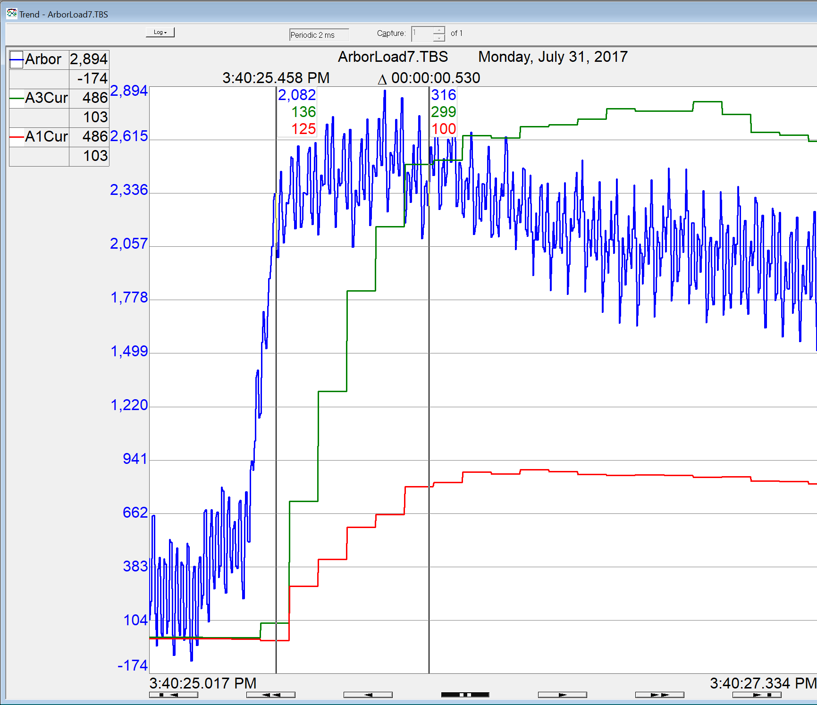
This zoomed in view of a trend on the HDA shows the force occurred more than a half second earlier than the arbor motor could react. Again force is blue and arbor motor amperage is green for the bottom arbor and red for the top arbor.

Slide 19
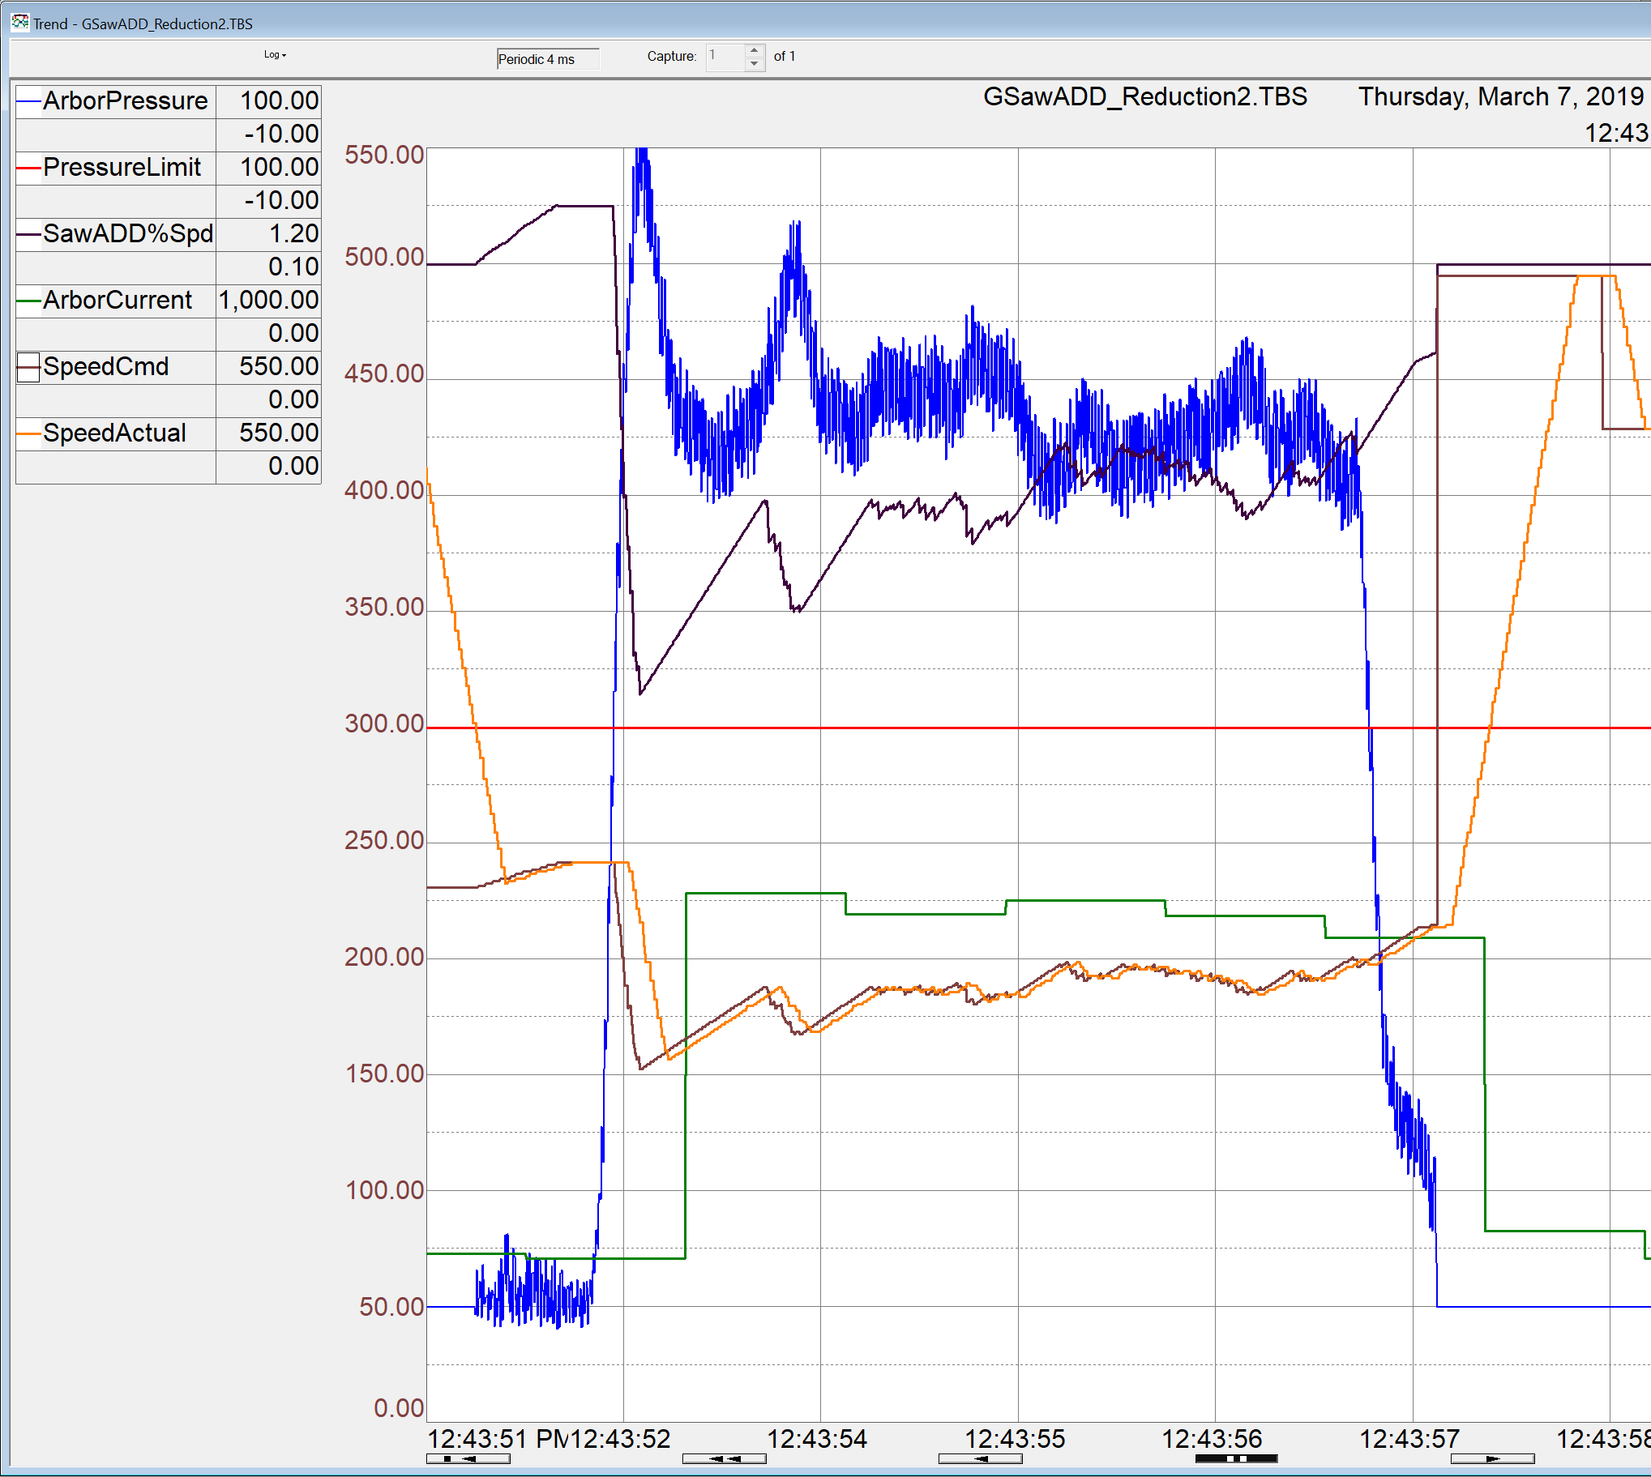
This trend on a VDAG shows Saw-ADD’s detection of excess forces on the leading arbor (blue) far sooner and with greater resolution than the arbor motor current (green)

Slide 20

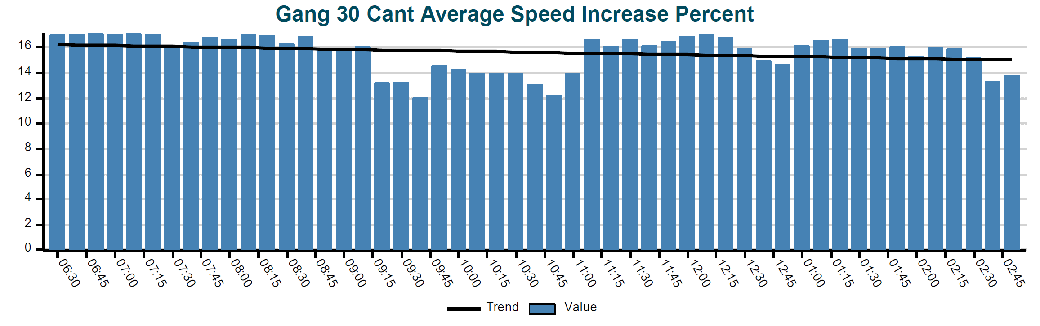
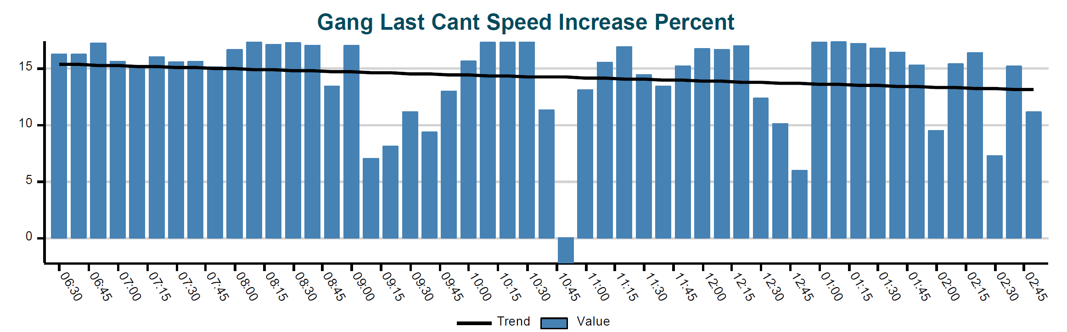





This upper graph shows the gang performance over an 8 hour shift on Douglas Fir. Each bar is the last 30 cant average percent speed increase over optimizer speeds. The black line shows the increased average is holding steady near 16% even without a saw change for that shift.
Each bar is the last single cant speed increase in the 15 min window, which can be a decrease if needed to save saws

Slide 21
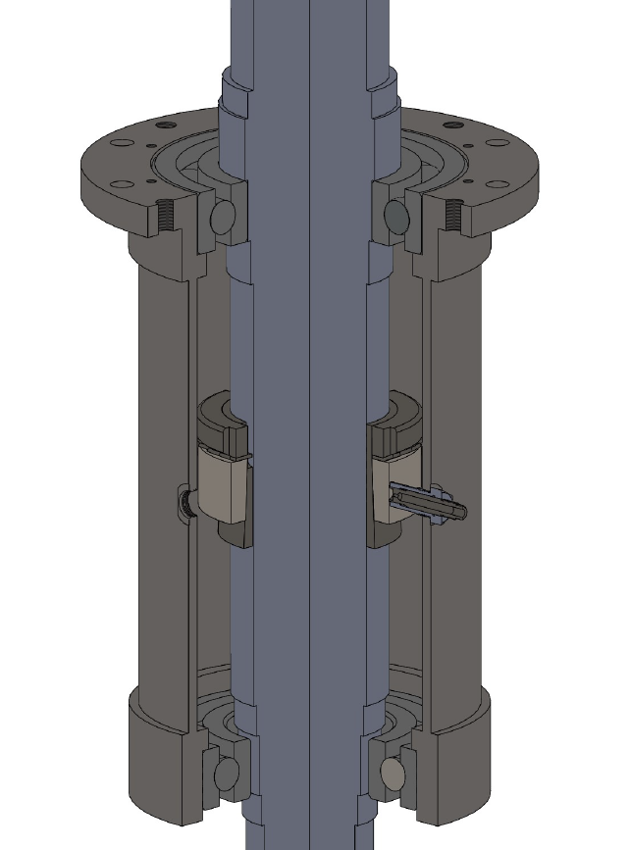

This cutaway of a V-DAG cartridge shows the addition of a target ring on the arbor and sensor boss O ring holes to accommodate a sensor holder
Target Ring
Sensor Hole
Sensor Holder

Slide 22
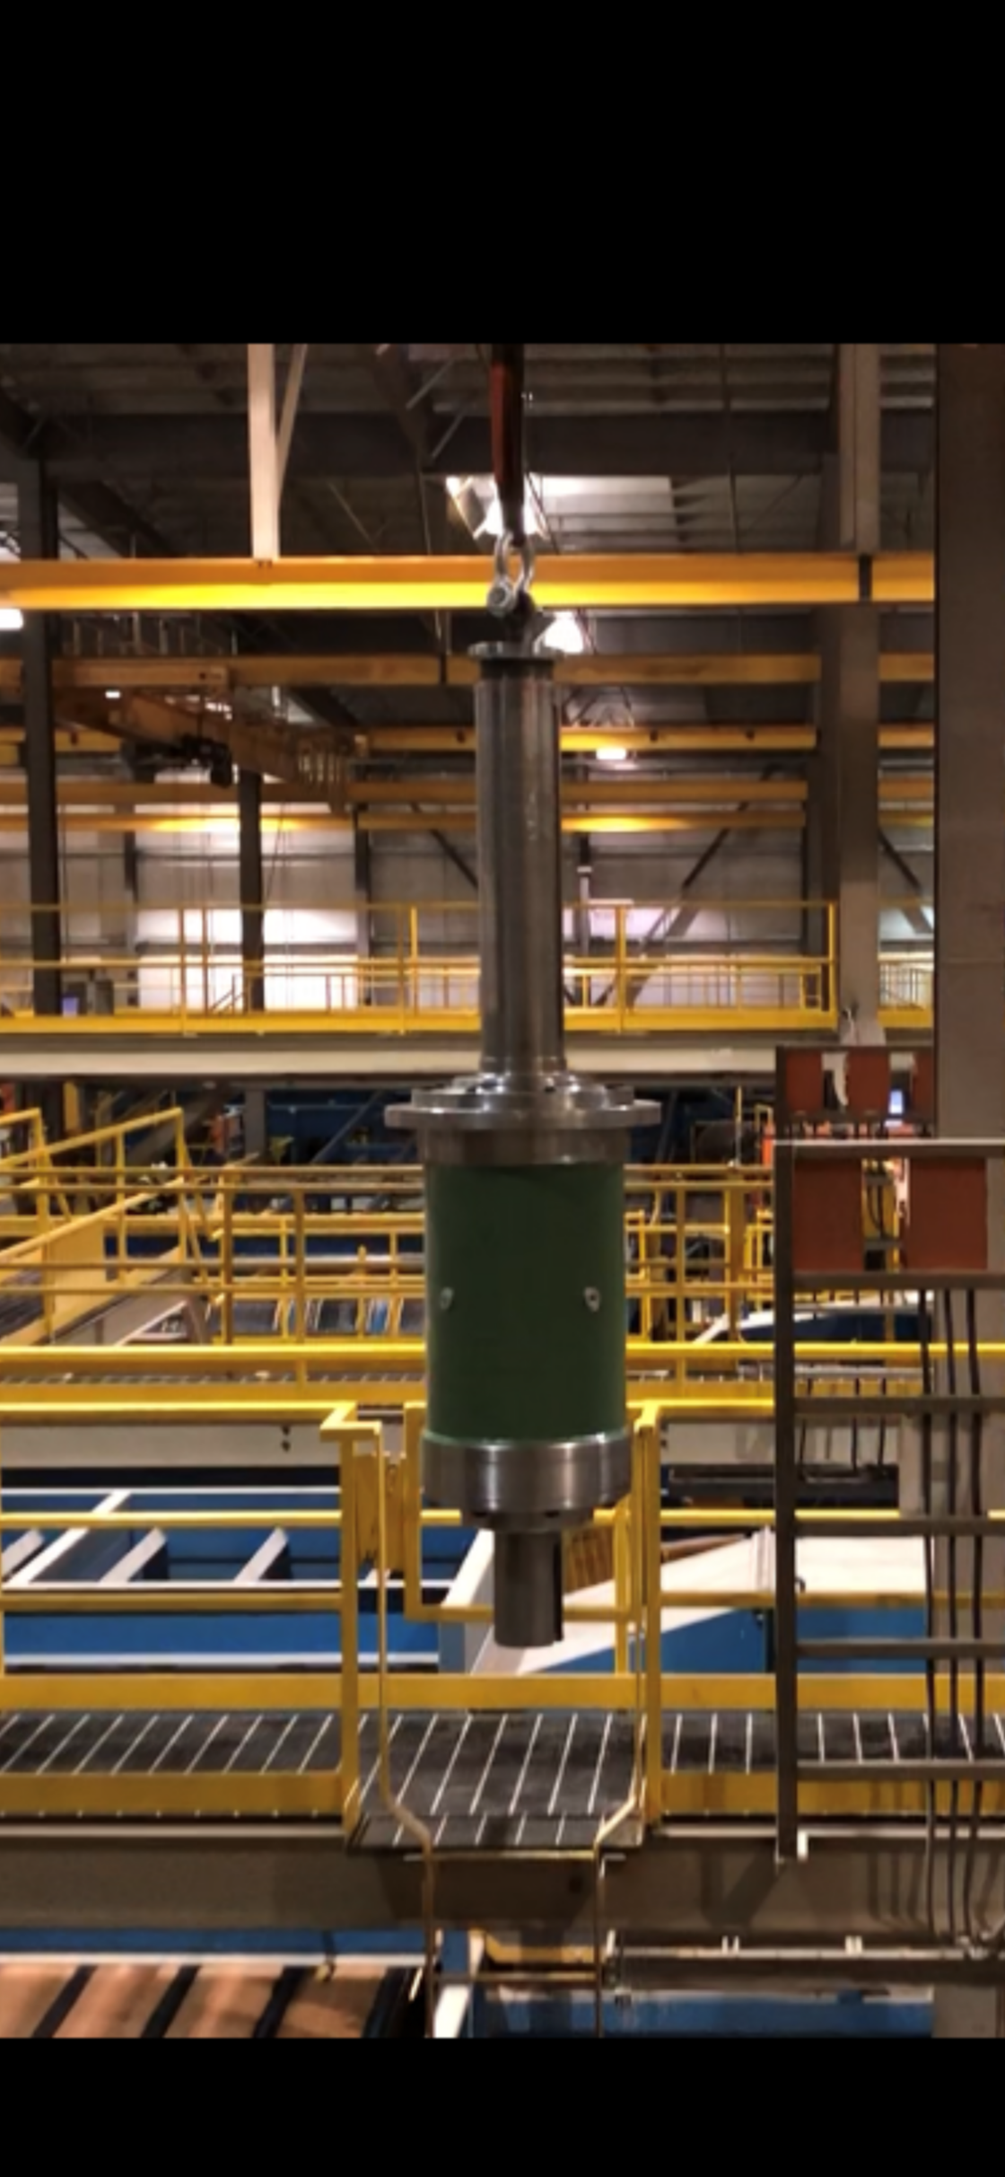
The arbor cartridge is fitted with Boss
O-Ring plugs at 90 degrees and is ready for the SawADD installation.

Slide 23
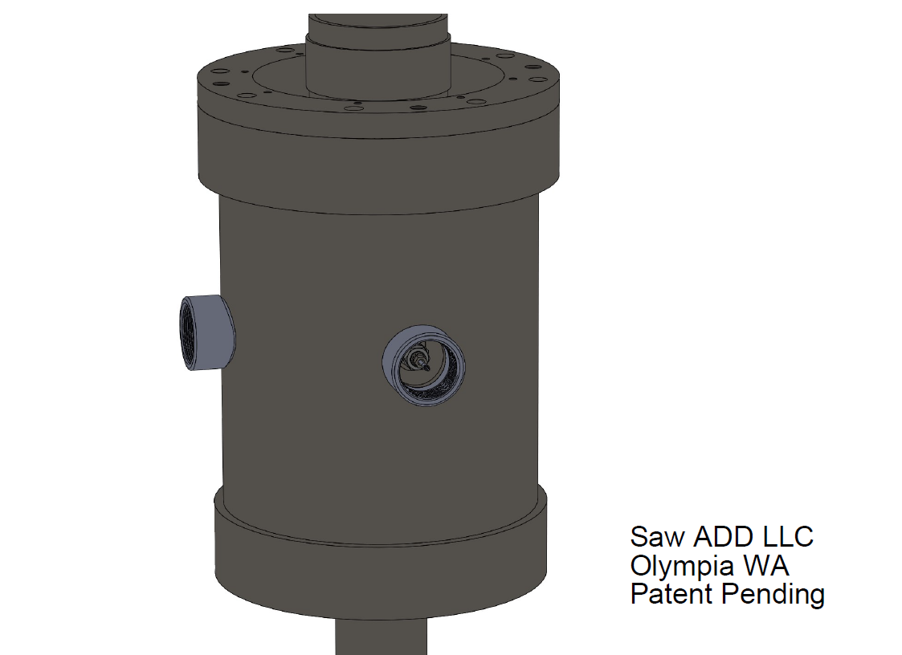

Holes are cut in the cartridge shell and 2” pipe saddle tees are welded over the holes to accept a pipe plug, before installing the Arbor.
Sensors are mounted in Boss
O-Ring fittings and connecting cables are run between the cylindrical shells and out the door. This makes the sensors and cables extremely well protected.

Slide 24
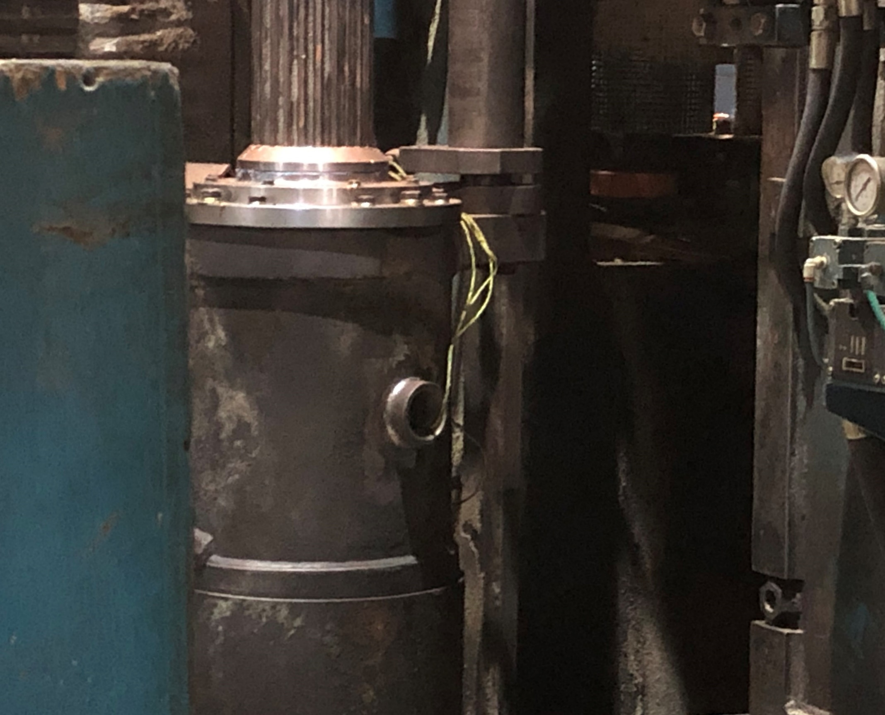
The Arbor is installed in the cartridge shell with strings left between shells to pull in SawADD sensor cables.
Boss plugs will be removed and replaced with sensor assemblies

Slide 25
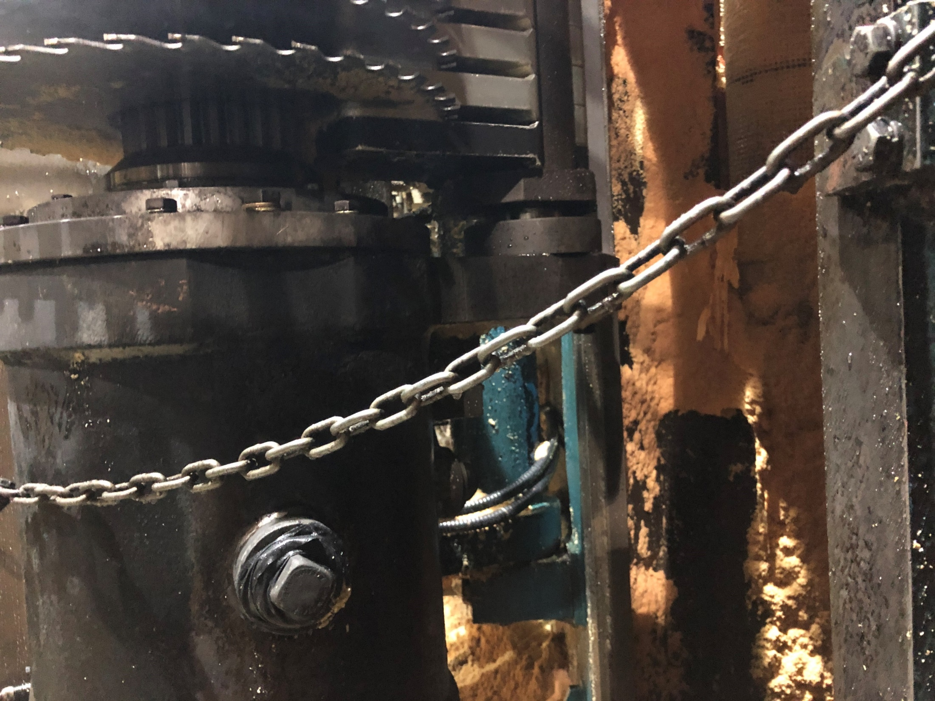

Pipe plug covers provide protection for the sensors

Slide 26
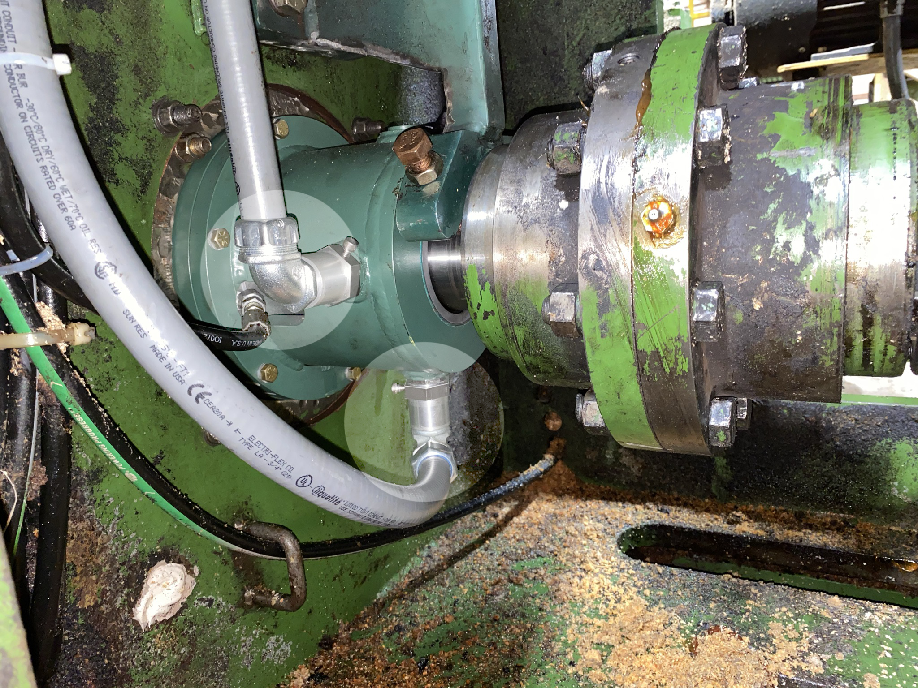
On HDAs an extended bearing cap will be provided for the sensors and target ring.
Conduit adapters are provided for sensor cables

Slide 27
Customer Feedback
The only saw wrecks they had for an entire year since installing SawADD where caused by log chunks jamming etc. Yet they had SawADD up to as much as a 25% increase. The only stuck cants were due to power failures on site, again unrelated to SawADD. And there has been zero maintenance on Round SawADD.
“It has been a great improvement to our sawing accuracy and thru-put.”

Slide 28
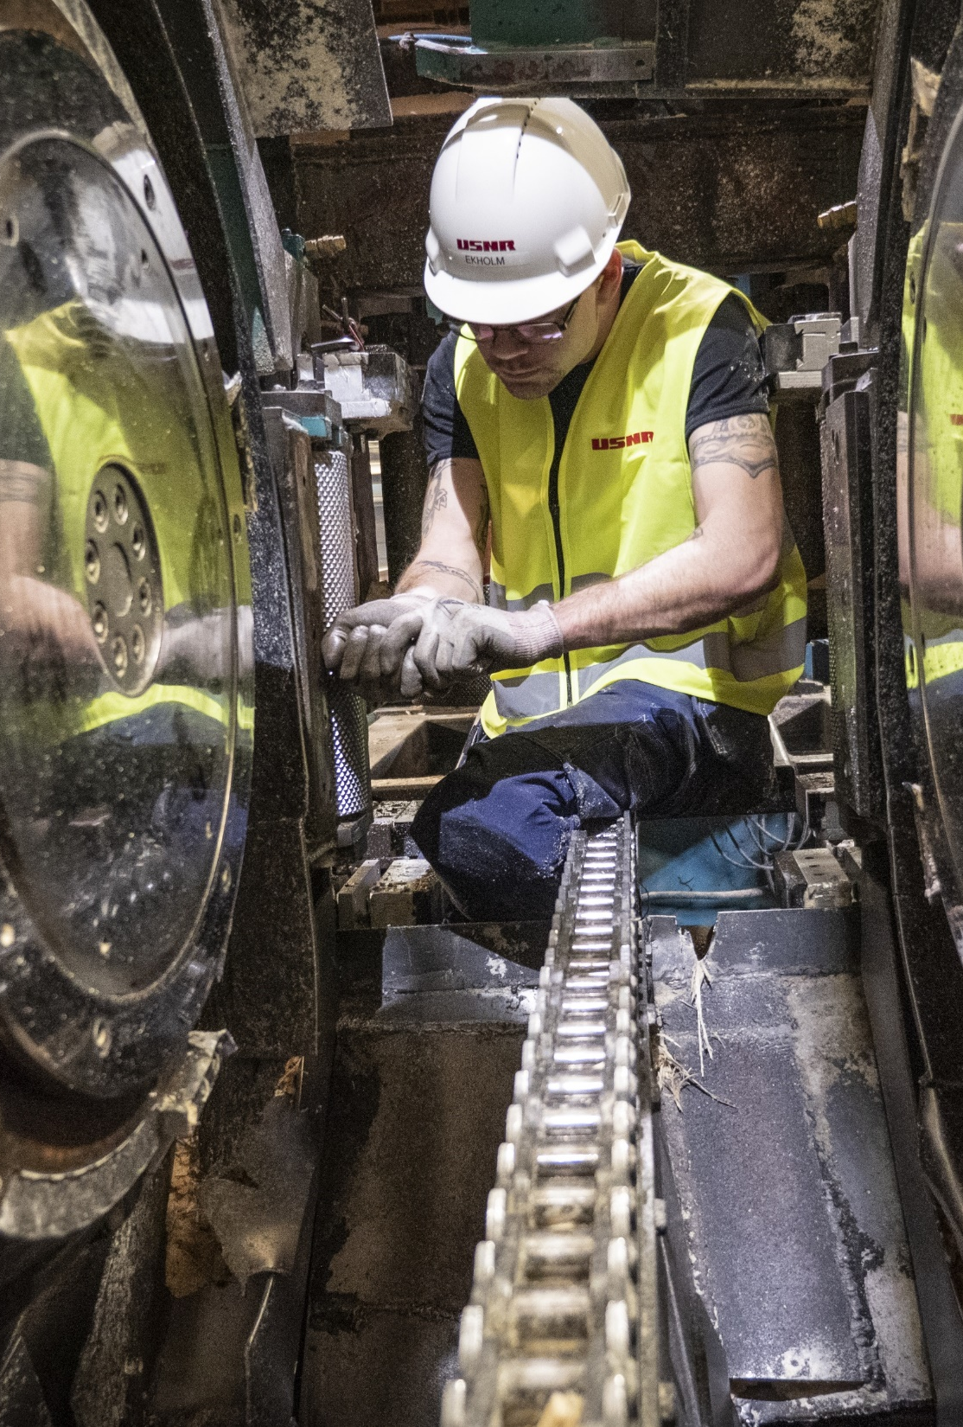

The USNR Distributor Advantage
Extensive Installed Base – USNR is the largest supplier of wood processing equipment in the world, offering state-of-the-art machinery and complete systems for sawmills, planer mills, OSB, LVL, plywood, veneer, glulam, and CLT manufacturing plants. The company has installed 33 sawmill cutting systems over the last 30 months.
Largest Service Team in the Industry – More than 75 field service technicians will be available to support Saw-ADD products. USNR provides assurance and confidence. More than 20 USNR service techs are mechanical service specialists that can supervise Saw+Add installations.
Dedicated Upgrades & Conversions Group – A team of 5 dedicated professionals are focused on upgrades and conversions, providing extremely fast quote turnaround times. This group remains involved in the process from initial inquiry all the way through installation and startup.
Project Management – USNR will assign a project manager to each Saw-ADD conversion who is responsible for managing all aspects of the project, from coordinating with engineering to modifying or updating drawings, tracking manufacturing progress, scheduling the resources, and coordinating timing for installation and startup.

