Slide 1


Introducing Saw-ADD The worlds ONLY
Anti Deviation Device for Bandsaws!

Slide 2

Effective Feedback
Allows the cutting process to:
react immediately to anomalies
adapt to changing conditions
maintain accuracy
get maximum throughput.
Wood is very non-homogeneous and without Effective feedback:
saws will deviate
become damaged
and cause downtime.

Slide 3
Force Feedback Invention
Measuring lateral forces directly on Bandsaw blades
The physics of motion demand that force happens first, causing acceleration and then displacement happens.
Think about the inertial force you feel when your vehicle first starts to accel or decel.
A blade feels steering force before deviation occurs and the feedspeed can be preemptively adjusted proportionally, slowing only when needed, then instantly ramping back up.
No more need to run conservative speeds to prevent deviation and crashes.

Slide 4
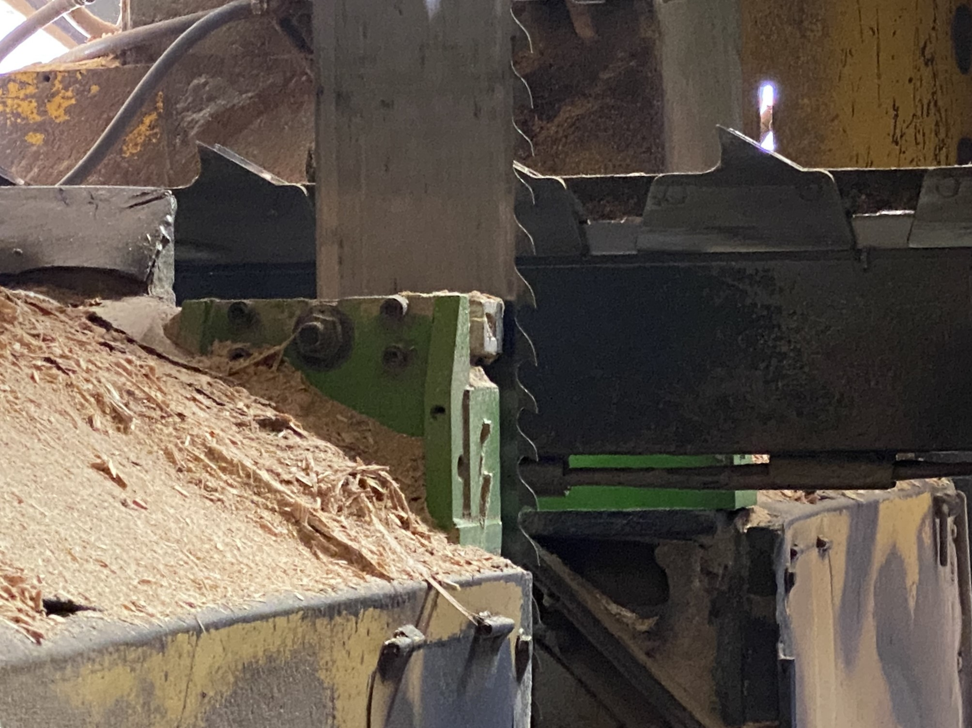
With Saw-ADD you get…
Increases up to 15%, (because 80% of wood can be cut faster)
Higher recovery
Better grade
Less saw damage
Less downtime
Lower maintenance
Longer machine life
Payback less than two months

Slide 5
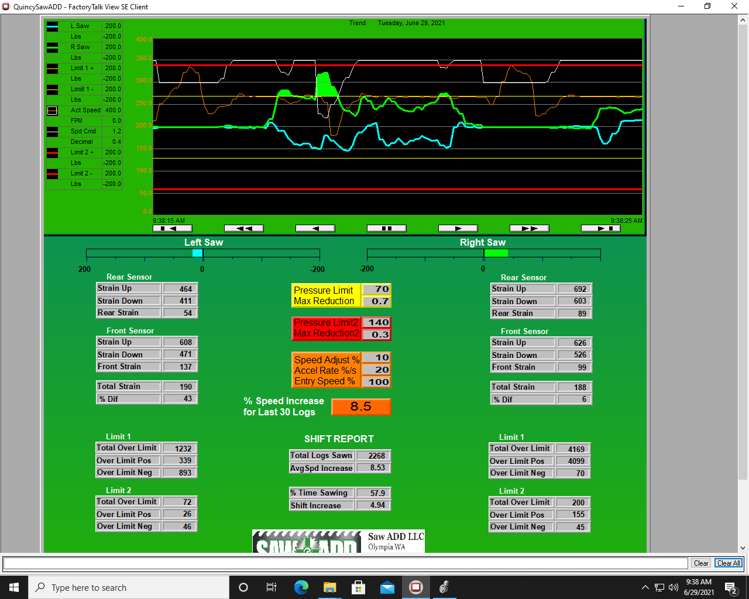

Slide 6
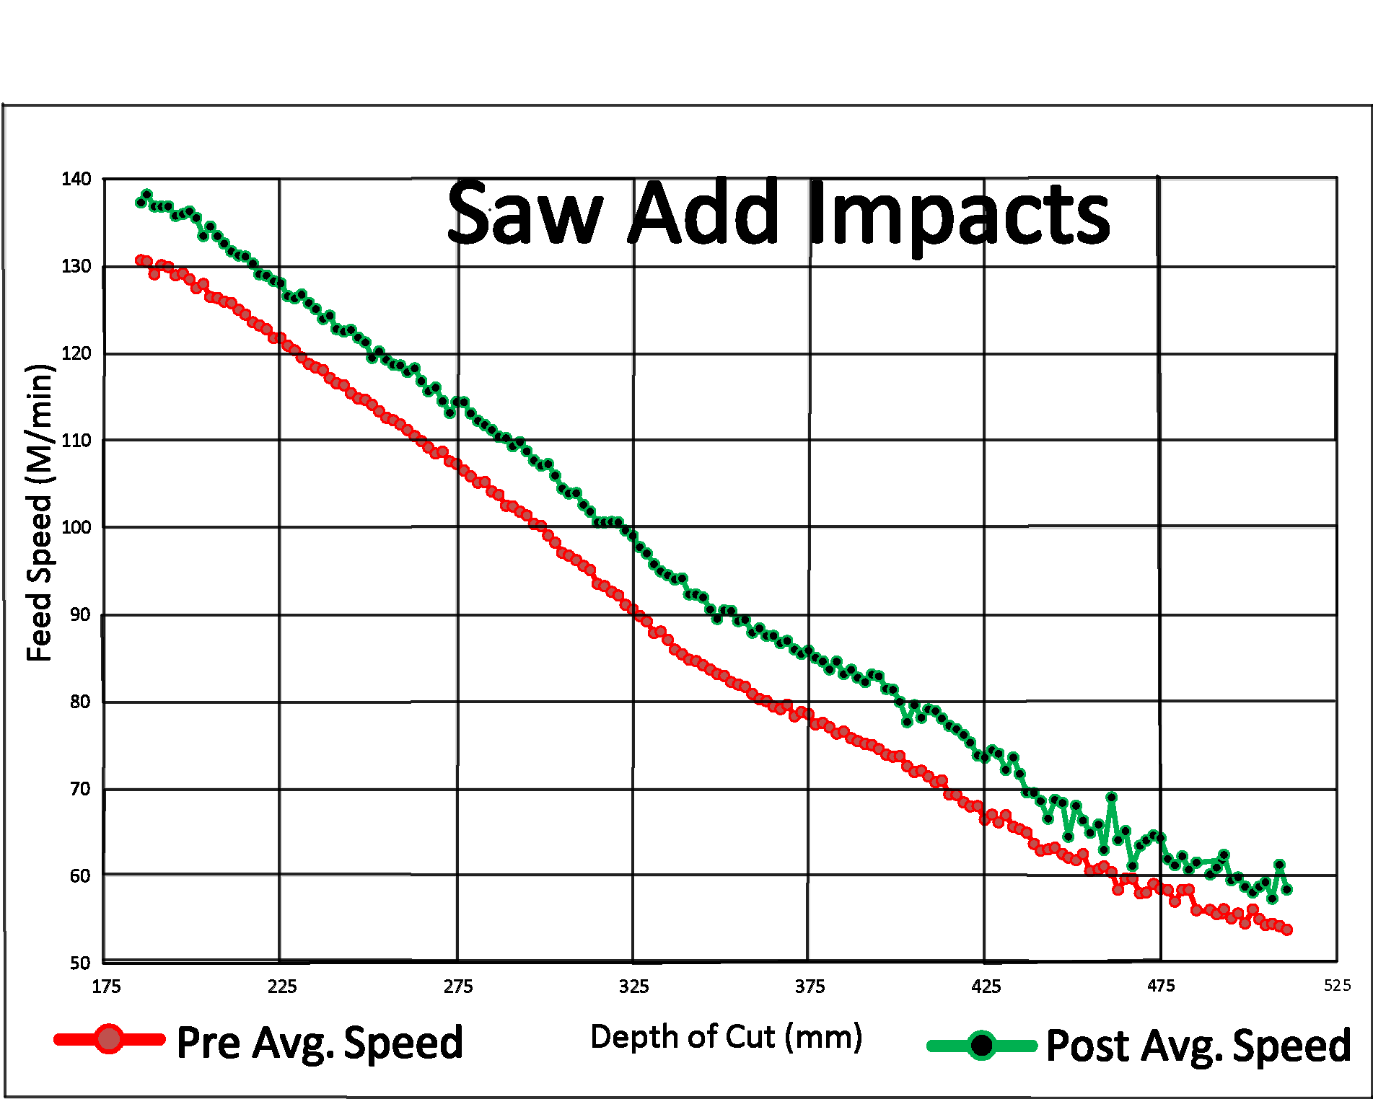
Month of data showing a nearly 8% average speed increase across all depths of cut
The red line is before Saw-ADD. The green line is after. Each dot on the lines represents 100’s of logs in each depth of cut
Each line-dot represents hundreds of logs.

Slide 7
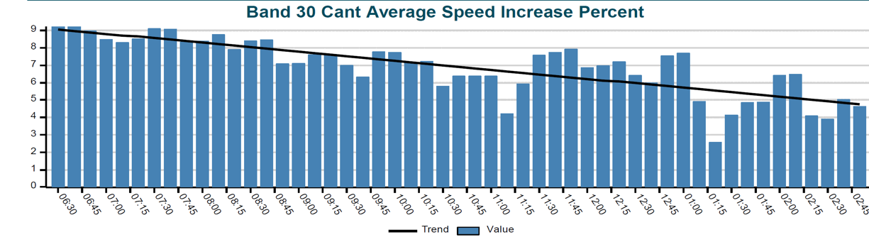




Chart shows bandsaws performance over a shift sawing frozen wood. Each bar is the 30 cant average percent speed increase over optimizer speeds. Notice the increase reduces as the saws get tired. Before Saw-ADD they would not have lasted an entire shift. If left on past lunch they would have wrecked. The speed is increased by the requested 10% upon entry and then reduced as necessary through the log. For nonfrozen wood the requested increase was as much as 15% and averaged over 10%.

Slide 8
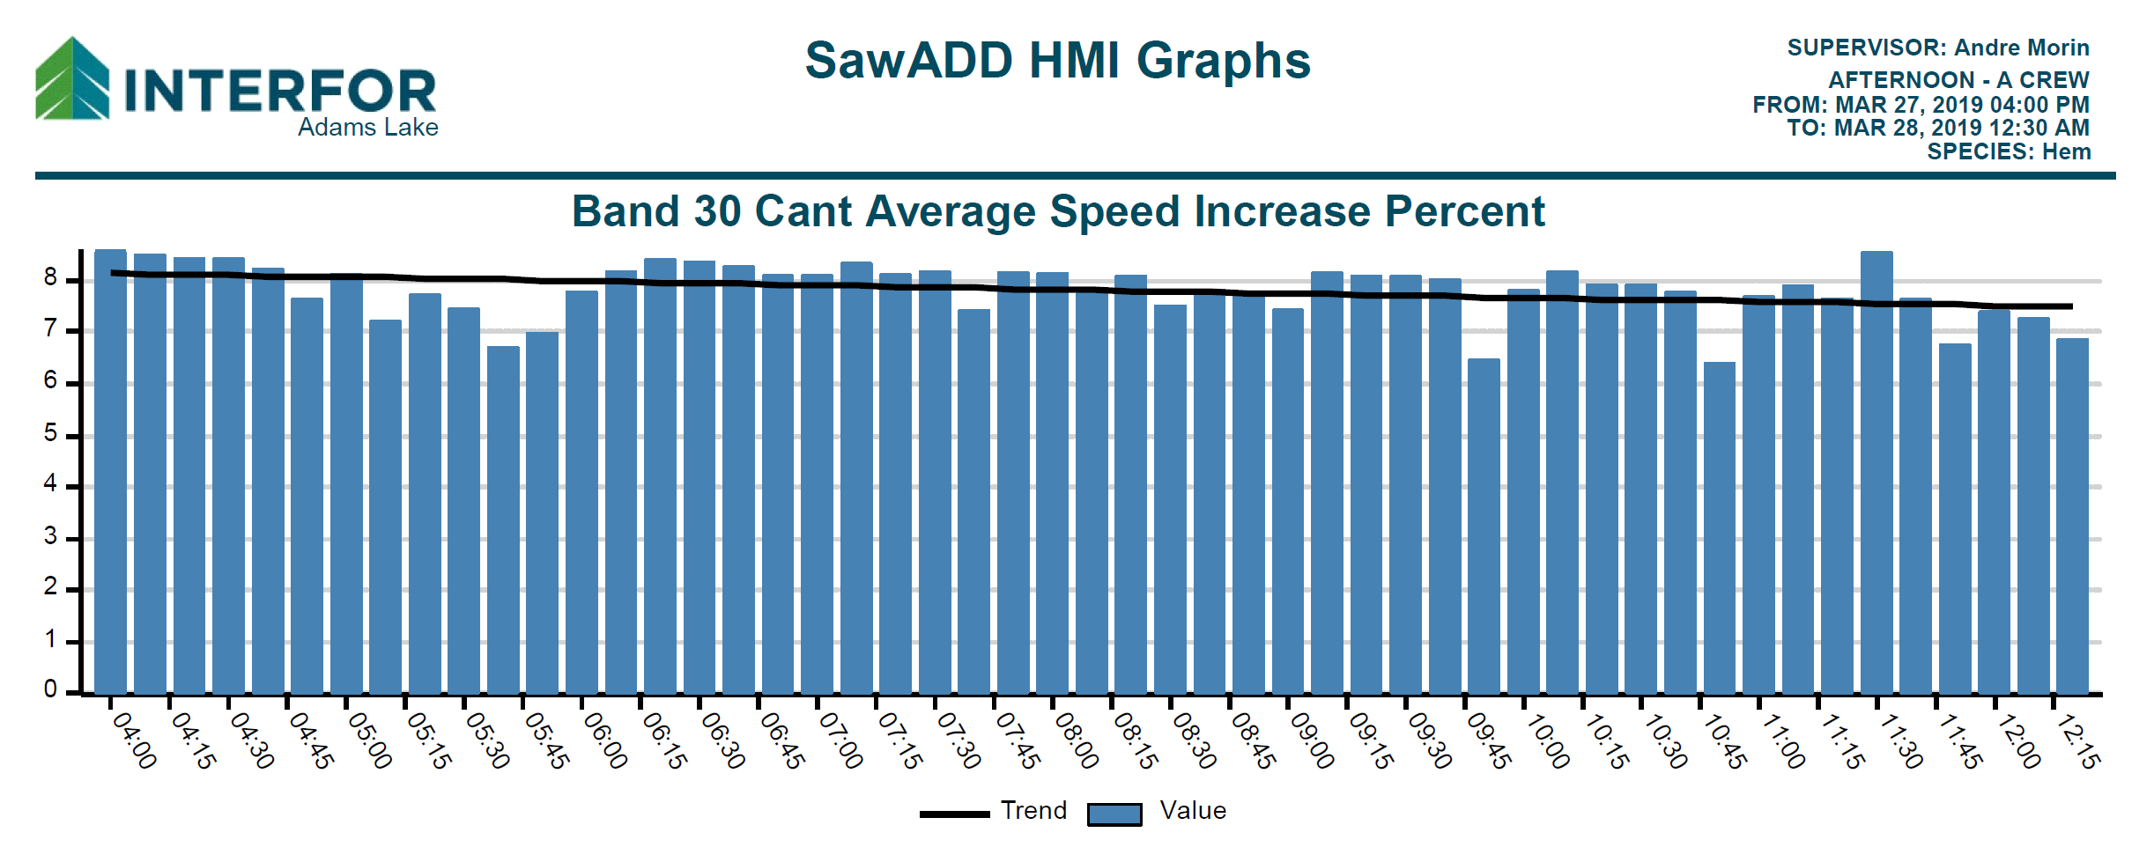
In this graph, notice the black line indicating the average is holding steady near an 8% increase with
Saw-ADD when cutting Hemlock

Slide 9

Saw-ADD is the only anti-deviation system available!
Top guide systems can only measure deviation that has already occurred. THAT’S TOO LATE!!
Saw-ADD keeps you ahead of the curve.

Slide 10
Introducing Saw-ADD The worlds ONLY Anti Deviation Device for Roundsaws!

Slide 11
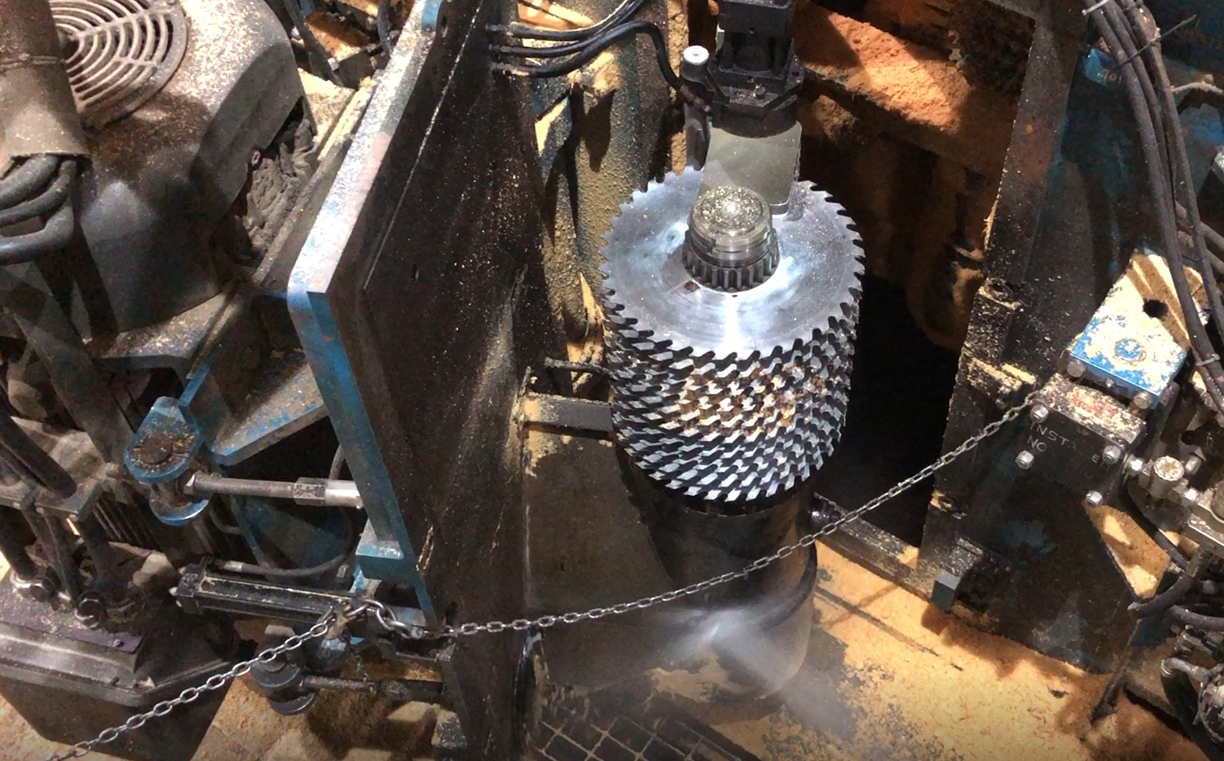

Round Saw-ADD is a patented saw and guide force sensing system. It measures the reaction forces on the arbor from the radial forces on the saw blades from the tooth cut and the guide friction.
Excess forces are a potential for deviation and saw damage. Saw-ADD virtually eliminates these by preemptively slowing the feed speed.

Slide 12
No maintenance had been required on Interfor’s VDAG arbor from the installation of Saw+ADD in 2019 until 2025 (over 5 years) when Saw+ADD was inadvertently turned off. Previously, bearings required changing every 6 months.
They lost a 500 HP motor and the arbor soon after Saw+ADD was turned off.

Slide 13


Slide 14
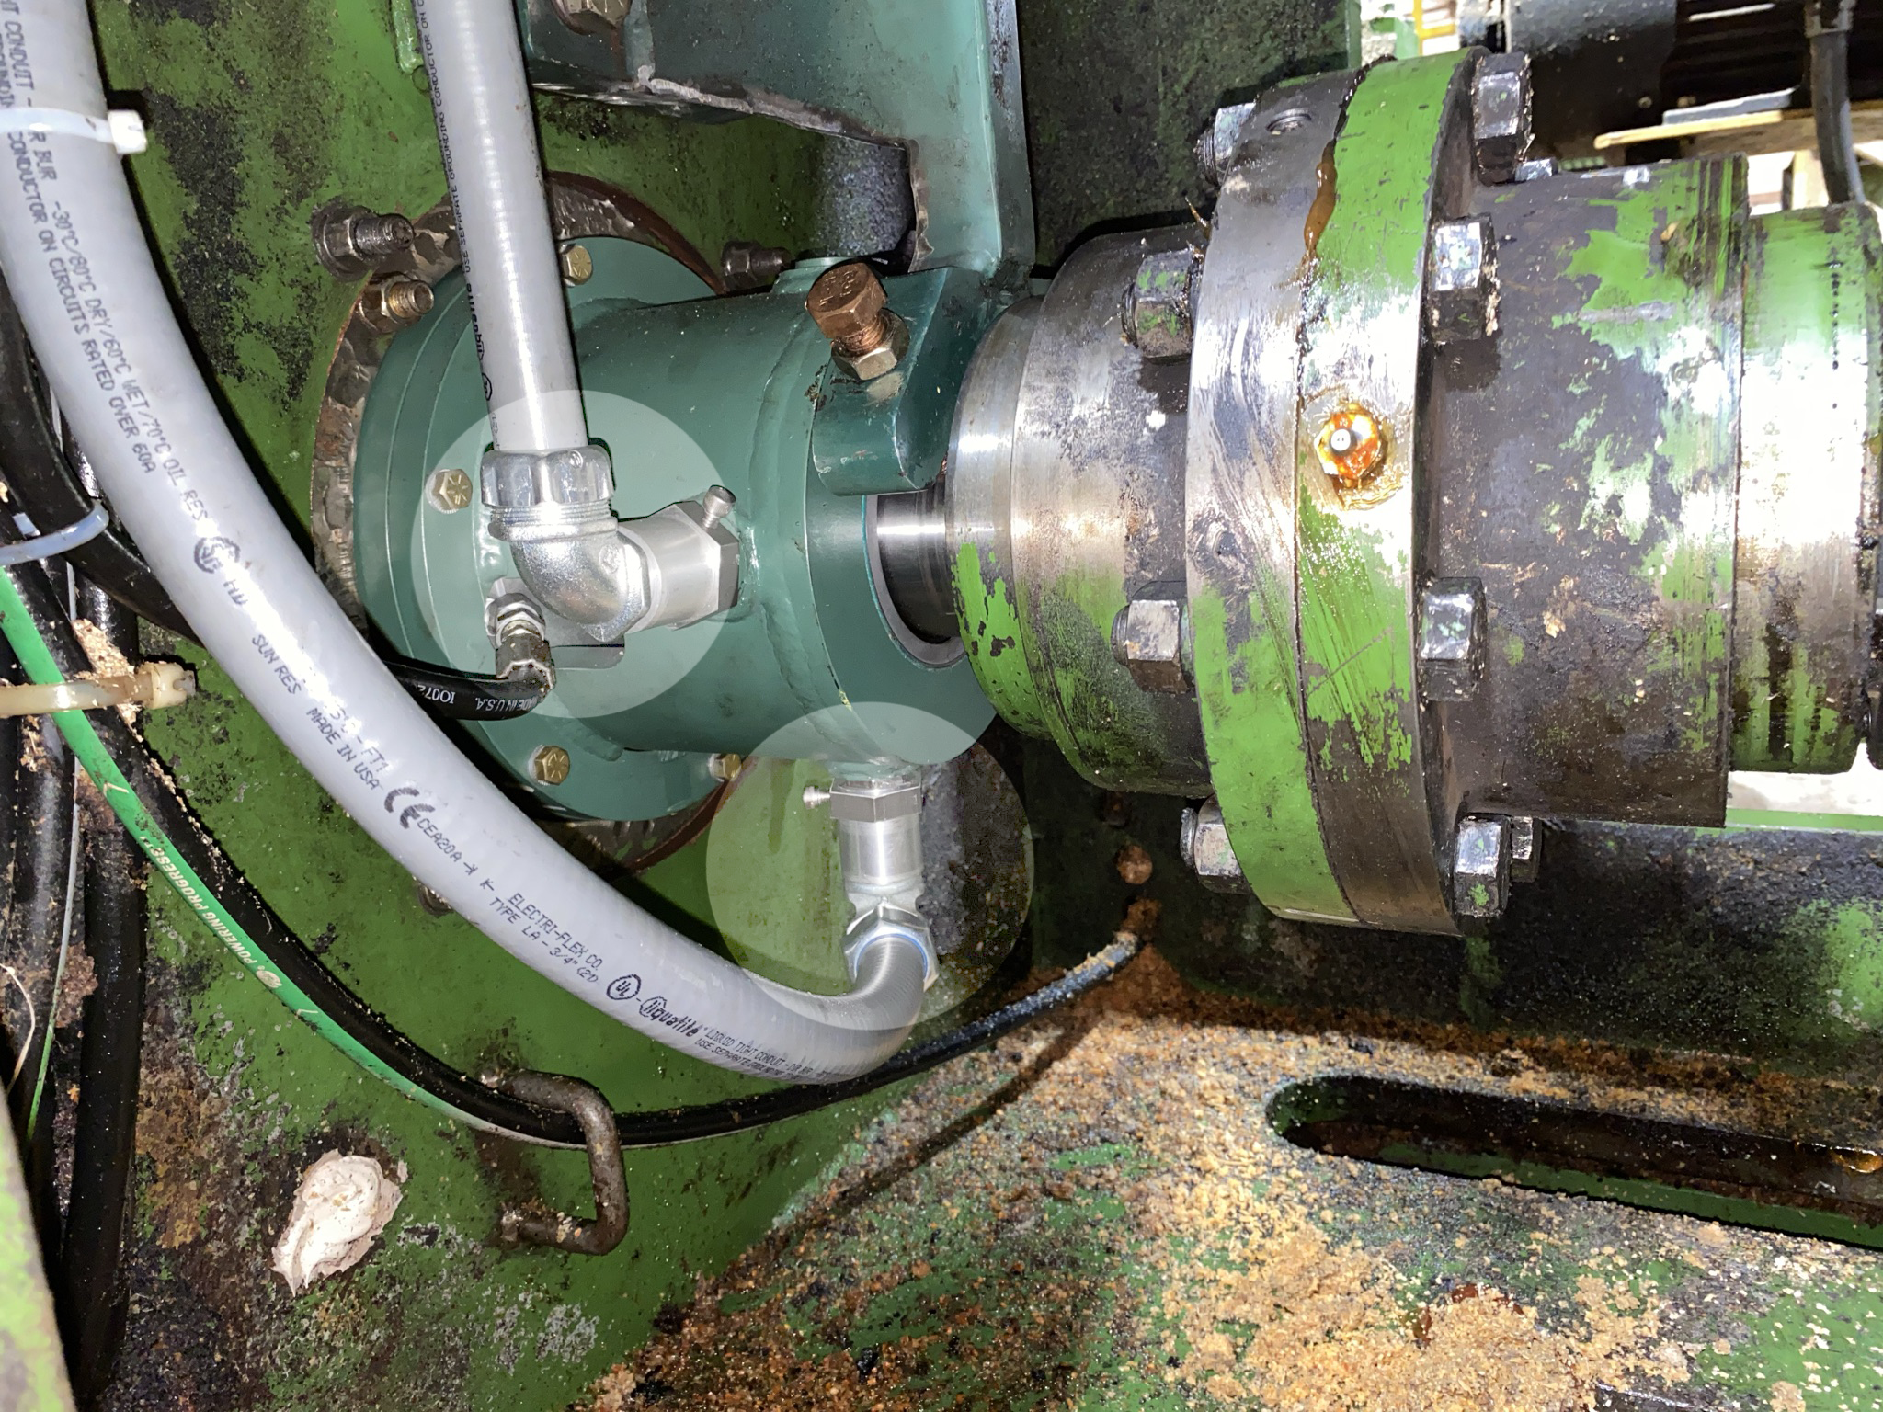
On HDAs an extended bearing cap will be provided for the sensors and target ring.
Conduit adapters are provided for sensor cables

Slide 15
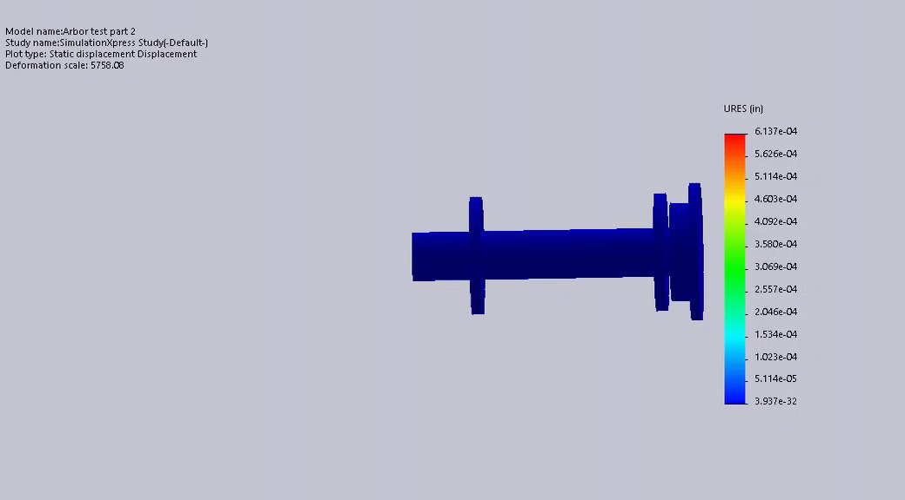

Actual movement is tenths of thousandths of an inch!
Saws
This is a simulation of radial forces on cartridge arbors caused by sawing and/or guide friction forces
(movement exaggerated).
Sensor placed here
Sensors on the arbor cartridge measure directional radial forces nearly a half second earlier than excess arbor current will occur.
Bearing
Bearing

Slide 16
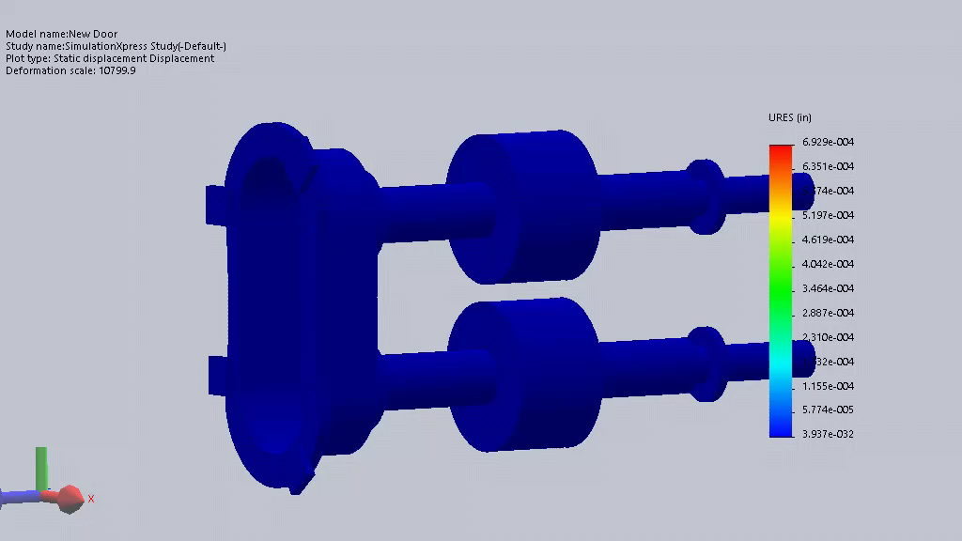

Saw ADD measures Radial Forces on Horizontal Arbors from outside the saw box. (movement exaggerated)
Sensor
tenths of thousandths of an inch!
Bearing
Bearing
Saws
Saw ADD closes the loop by automatically adjusting the feed speed during the cut.
This quick detection and subsequent action eliminates saw blade deviation which prevents sticking a cant or damaging saws
Saws
Bearing
Sensor
Bearing

Slide 17
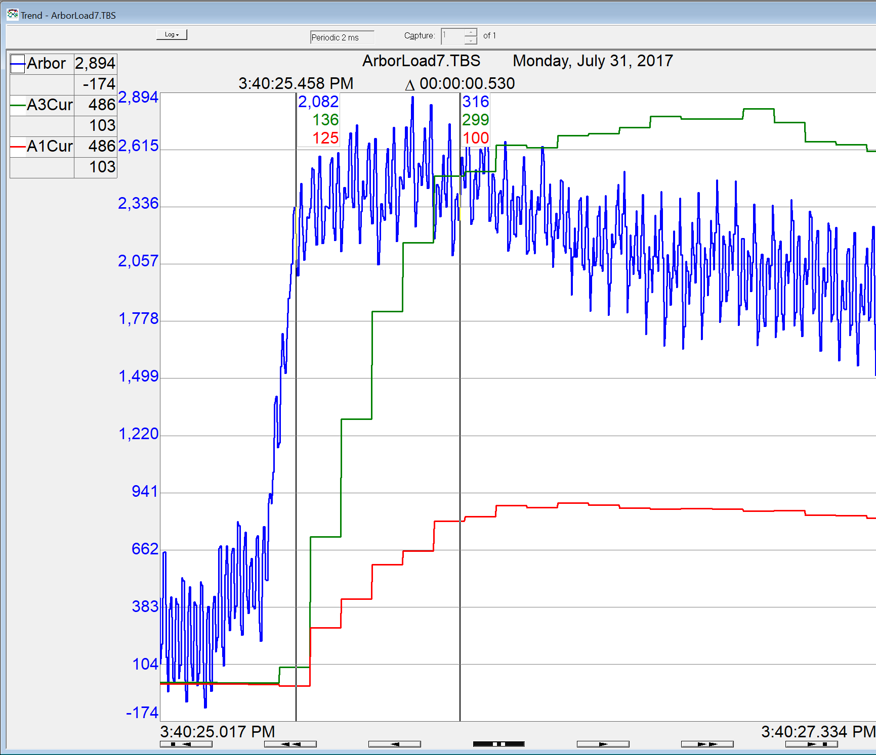

This zoomed in view of a trend on the HDA shows the force occurred more than a half second earlier than the arbor motor could react. Again force is blue and arbor motor amperage is green for the bottom arbor and red for the top arbor.

Slide 18

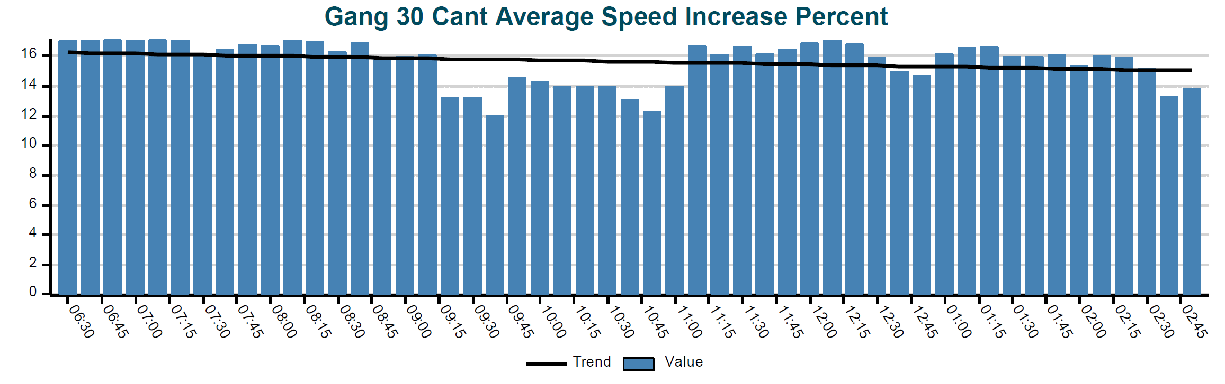
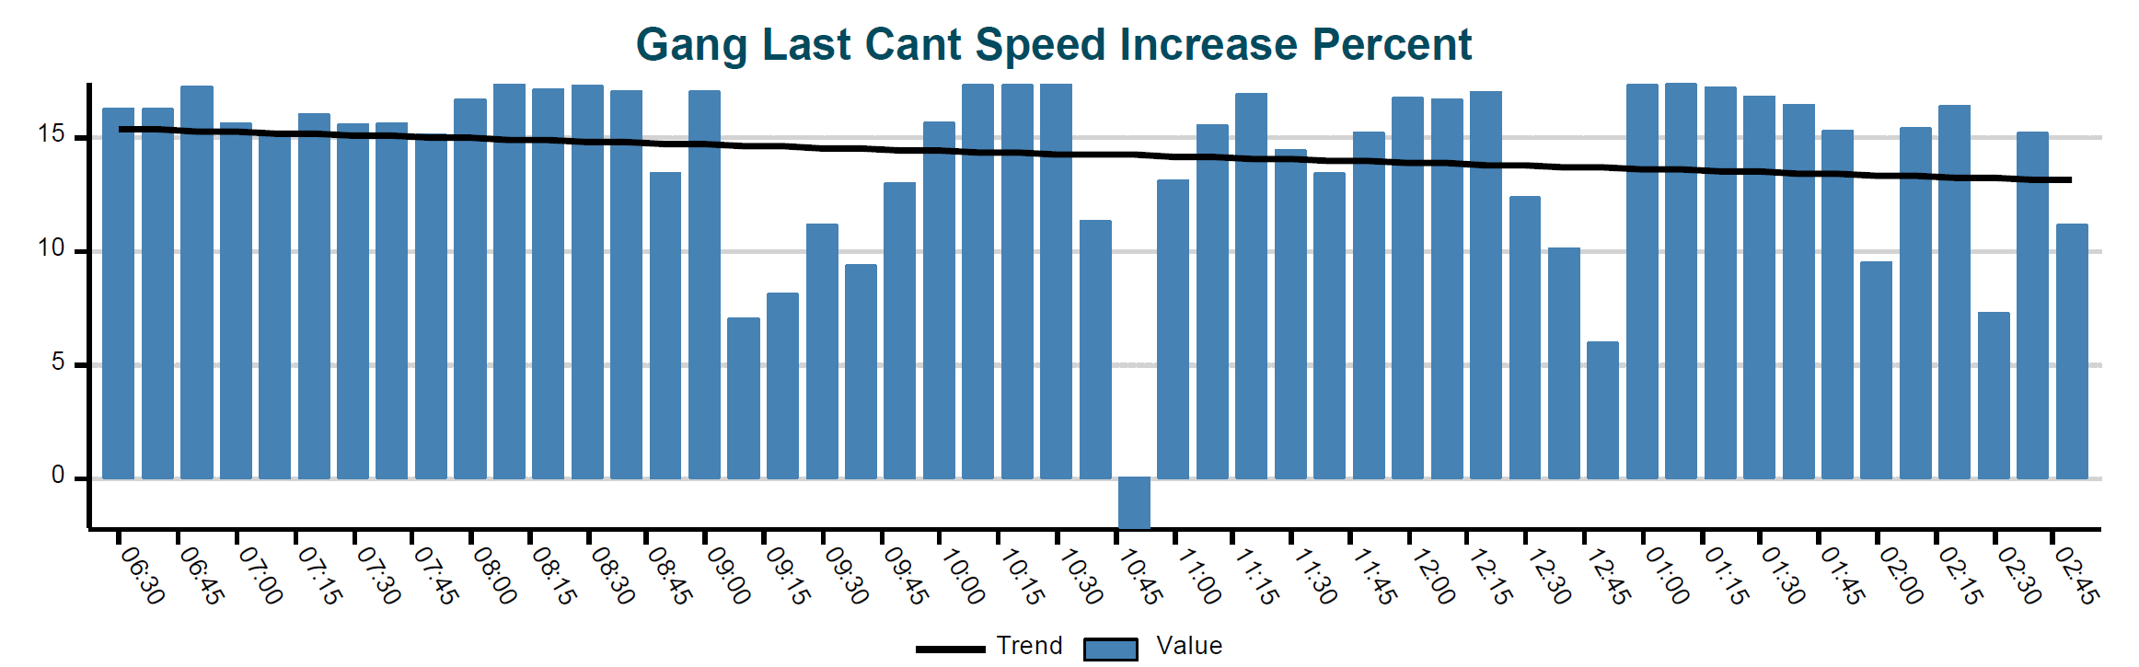





This upper graph shows the gang performance over an 8 hour shift on Douglas Fir. Each bar is the last 30 cant average percent speed increase over optimizer speeds. The black line shows the increased average is holding steady near 16% even without a saw change for that shift.
Each bar is the last single cant speed increase in the 15 min window, which can be a decrease if needed to save saws

